Slide 1

G2M Case Study
Virtual Internship
21-March-2024
By Bilikis Alayo

Slide 2
Business Problem
Background – The Client
XYZ is a privately owned company located in the United States (US). Given the significant expansion of the Cab Industry in recent years and the presence of several major competitors, the organization is positioning itself to invest in the Cab industry
Problem Statement
The company want to do a thorough market analysis as part of its Go-to-Market (G2M) strategy to have a clear understanding of the market before making a final decision.
Objective
To generate valuable insights that would assist XYZ in identifying the most suitable cab company for its investment.

Slide 3
Data Analysis Approach
The data analysis approach will be carried out as follows:
Data Intake and Exploration
Investigate taxi companies that offer favourable investment prospects comparing companies based on:
1. Revenue generation and profit analysis
2. Client retention rate and market share analysis
3. Other Features comparison
4. Holiday service and availability
Investment recommendation.

Slide 4
Data Intake and Exploration
Datasets details
Five files were merged and used in this analysis. These files include:
Cab_Data.csv, City.csv, Customeer_ID.csv, Transaction_ID.scv, and Us_Holiday_Dates.csv
The merged dataset consists of
359393 data points
20 Features (including 4 derived features)
Timeframe of the data: 2016-01-31 to 2018-12-31
Assumptions
The following assumptions were made
The "Users" feature represents the total count of all taxi passengers in a city, regardless of the specific taxi company they use.
Profit is calculated only based on the Price_Charged and Cost_of_Trip features. All other variables are held constant.
There are outliers in the Price_Charged feature, but it was not considered as outliers because of the unavailability of information about the trip duration.

Slide 5
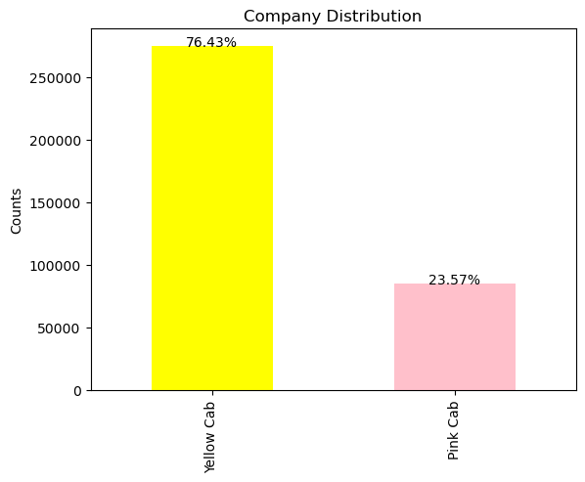
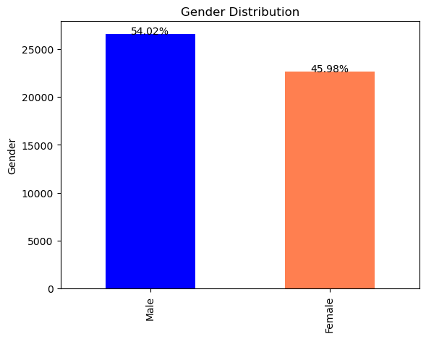
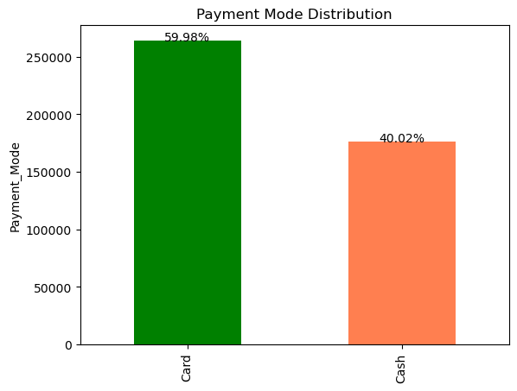
Key Features Exploration
Figure 1: Company size distributions
Figure 2: Users’ Gender distributions
Figure 3: Mode of payment distributions
According to the data, the proportion of yellow taxis (76.43%) is three times that of pink cabs (23.57 %).
Also, males (54.02%) account for a higher proportion of “Users” than females (45.98%)
The majority (59.98%) of the cab companies’ payments and revenue are transacted in cash.

Slide 6
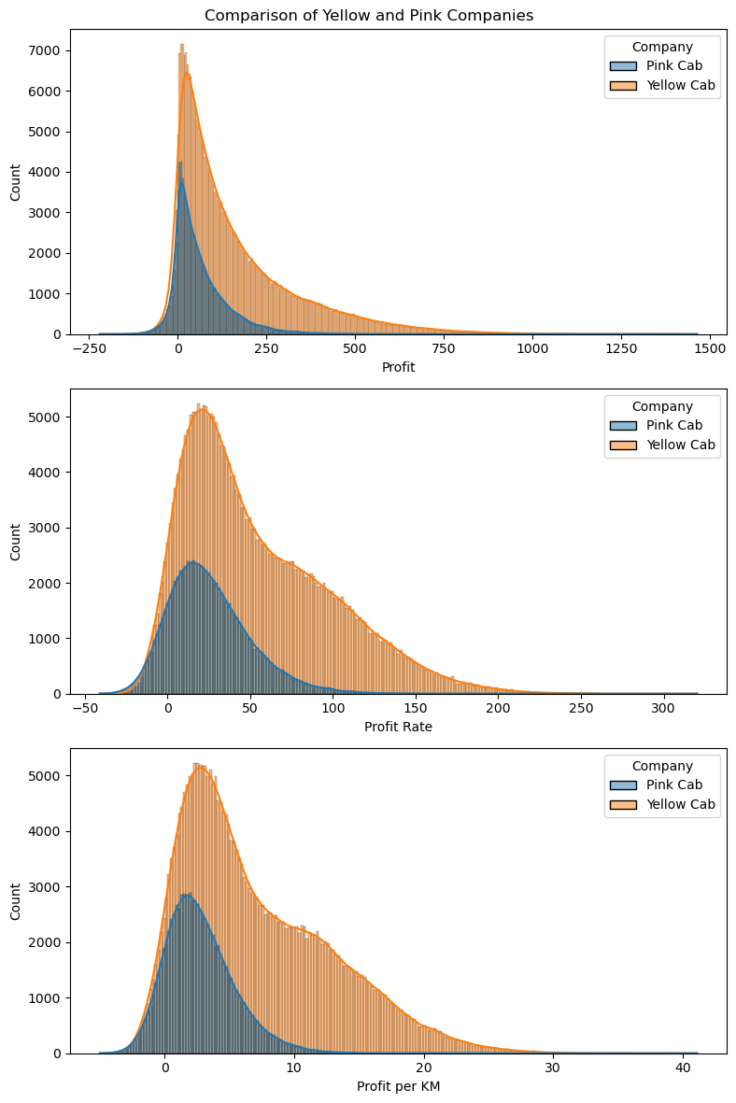
Profit Analysis
The proportions of each category of profit are rightly skewed.
Yellow Cab’s “Profit Rate” and “Profit per KM” distributions exhibit a noticeable rise to the right of the peak, which will likely result in a higher overall profit rate.
Figure 4: Cab Companies Profits’ Analysis.

Slide 7
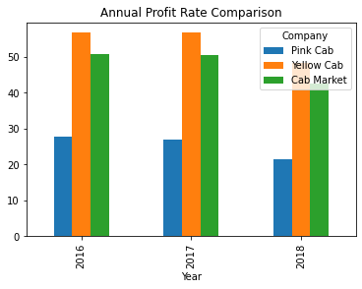
Profit Analysis (Contd)
Year | Pink Cab (%) | Yellow (%) | Cab Market (%)
2016 | 27.659727 | 56.719546 | 50.864915
2017 | 26.937759 | 56.744110 | 50.639303
2018 | 21.427914 | 48.213674 | 42.691567
Table 1: Cab Companies Annual Profit Rate Comparison
Yellow Cab consistently outperforms Pink Cab in terms of annual profitability, with a rate ranging from 48% to 56% compared to Pink Cab's rate of 21% to 27% in each documented year.
One reason is that Yellow Cab has a higher proportion of high-profit-rate journeys compared to Pink Cab.
Figure 5: Cab Companies Annual Profit Rate Comparison

Slide 8
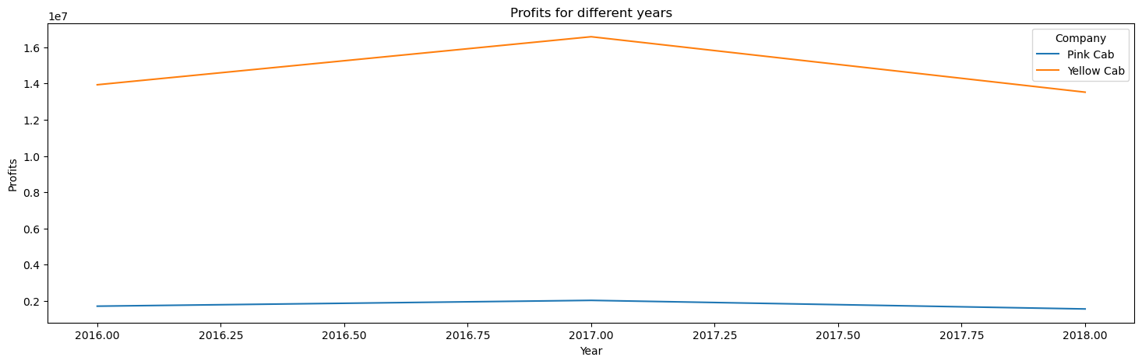
Profit Analysis (Contd)
Figure 6: Cab Companies Profit’s Analysis
Yellow Cab's profitability has been consistently superior to that of Pink Cab. Despite experiencing a profit peak in 2017 followed by a subsequent decline, this taxi service continues to outperform the pink cab.

Slide 9
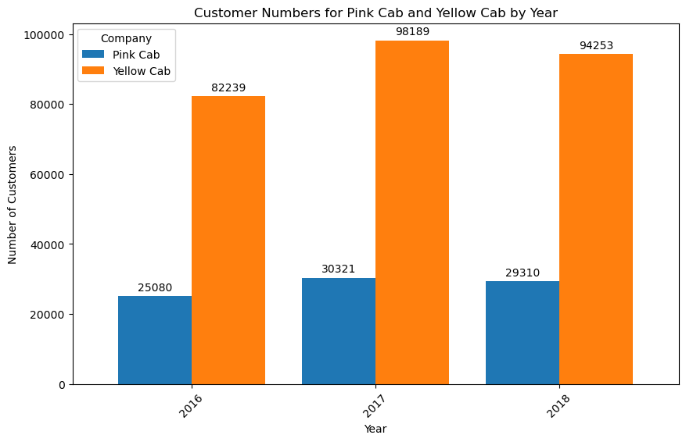
Customers Retention
Throughout the years being studied, the Yellow cab consistently had three times as many customers as the Pink cab.
This demonstrates that Yellow Cab has maintained a consistently high client retention rate over the course of those years.
Figure 7: Cab Companies Customers’ Analysis

Slide 10
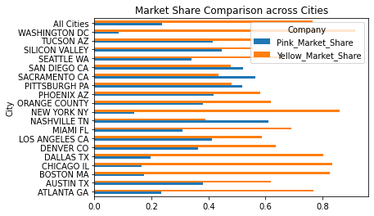
Market Share Analysis
Yellow Cap holds a market proportion that is almost three times larger than Pink Cap on a national scale.
Also, Yellow Cap's benefit is present in the majority of cities.
Given the strong correlation between the number of taxis owned by a company and its market share, this represents a consistent advantage for Yellow Cab.
Figure 8: Cab Companies Market Share

Slide 11
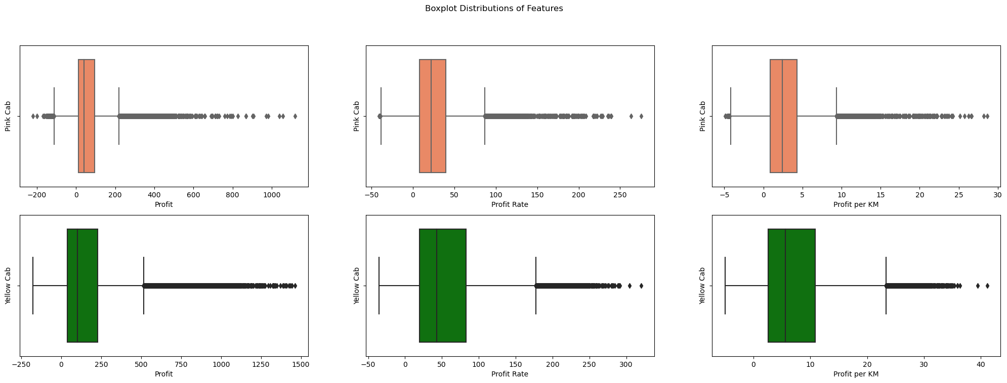
Features Comparison
Figure 9: Cab Companies “Profit”, “Profit Rate” and “Profit per KM” comparison.
Yellow Cab's profitability is relatively lower in the middle range, however, it has a higher number of high-profit rides. The “Profit Rate” and “Profit per KM” ratios of this company surpass those of Pink Cab, indicating a lower initial rate but a higher average rate per kilometre pricing approach.

Slide 12
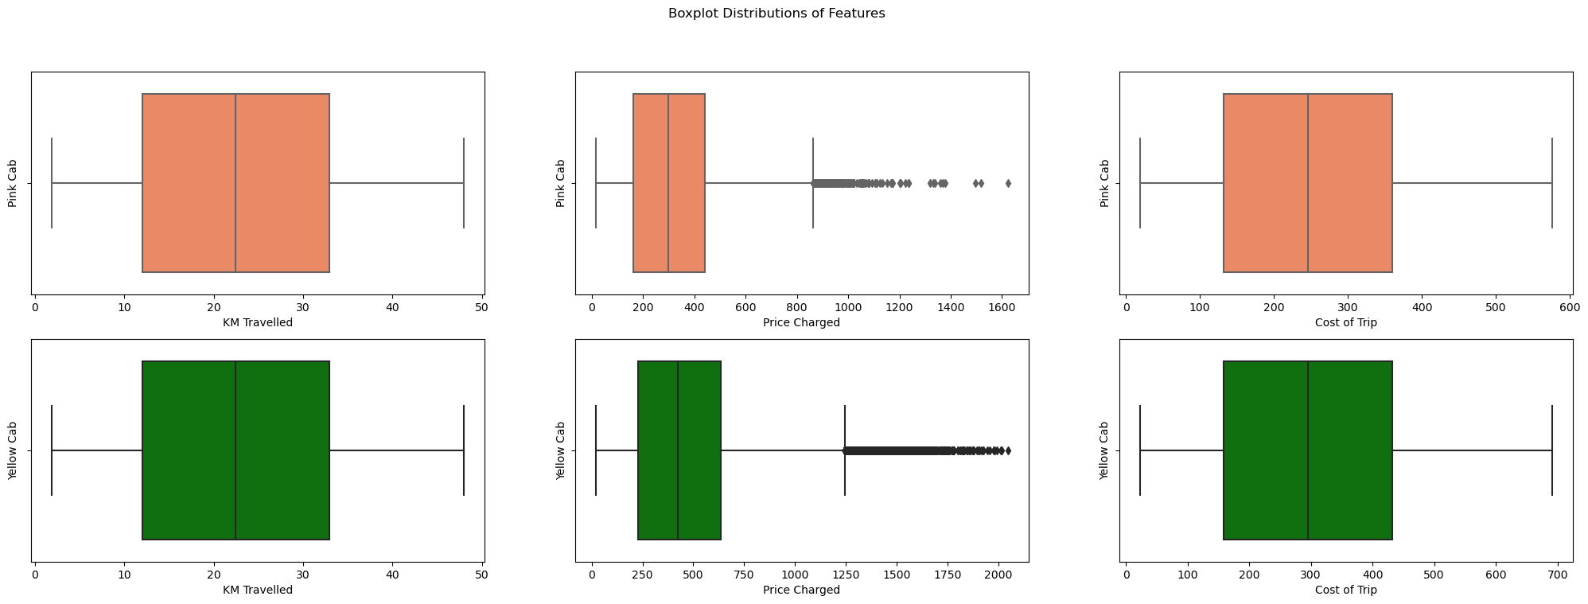
Features Comparison (Cont’d)
Figure 10: Cab Companies “KM Travelled”, “Price Charged” and “ Cost of Trip” comparison.
Both Cab companies exhibit comparable distributions of “Cost of Trip” and “KM Traveled”.
However, Yellow Cab exhibits a higher proportion of trips priced at a higher amount and a greater medium in “Price Charged”.

Slide 13
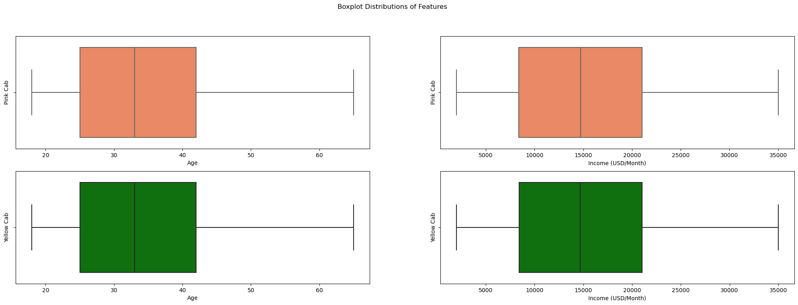
Figure 11: Cab Companies Users’ “Age” and “Income” comparison.
The statistical characteristics of the “Age” and “Income (USD/Month)” variables for Pink Cab and Yellow Cab clients are equal, demonstrating that the two companies' clients are in similar age categories and income ranges.

Slide 14
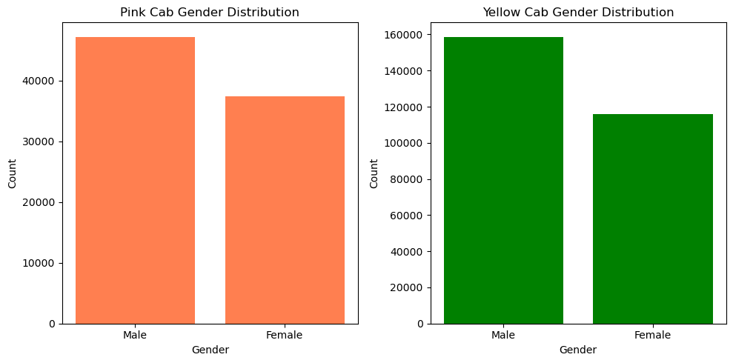
Features Comparison (Cont’d)
Both cab firms have equal preference from clients in terms of gender, with the male gender having the biggest proportion in both companies.
Figure 12: Cab Companies Clients “Gender” comparison.

Slide 15
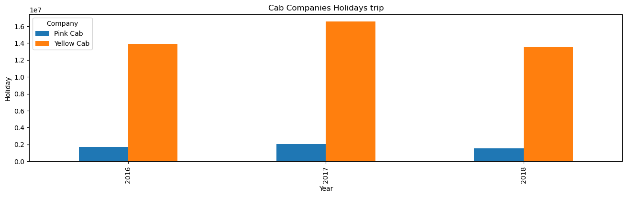
Holiday Availability
Based on the analysis, the yellow taxi provided superior service and was more readily available throughout the holiday period in comparison to the pink cab.
Figure 13: Cab companies’ Holiday trips.

Slide 16
Recommendations
Upon comparing the two taxi companies on the following criteria, we have determined that Yellow Cab is preferable to Pink Cab:
Profit Rate: In every year for which data is available, Yellow Cab has generated a greater annual profit rate (48%-56%), surpassing Pink Cab's (21%-27%).
Customer Reach: Yellow Cab has a greater customer base in 15 cities, whilst Pink Cab has a greater customer base in 4 locations. Additionally, we have seen that Yellow Cabs is more effectively serving other taxi consumers in comparison to Pink Cabs.
Customer Retention: Throughout the study period, the Yellow taxi consistently attracted three times the number of customers compared to the Pink cab
Market Share: The market share of Yellow Cab is double that of Pink Cab. It is the dominant taxi service provider in the majority of cities, excluding Sacramento, San Diego, Pittsburgh, and Nashville.
Clients’ Age and Income wise reach: The statistical characteristics of the "Age" and "Income (USD/Month)" variables for Pink Cab and Yellow Cab clients are identical, indicating that the two companies' clients are of similar ages and income levels.
Consequently, the preceding analysis leads us to the conclusion that XYZ should consider investing in Yellow Cab.

Slide 17
Thank You

